Slide 1
Identifiability in model parameterization
M A Masud
May 15, 2026

Slide 2


Problem statement
$$\frac{dS_{}}{dt}=r_{S}\left(1−\frac{S_{}+R_{}}{K}\right)S_{}$$
$$\frac{dR_{}}{dt}=r_{R}\left(1−\frac{S_{}+R_{}}{K}\right)R_{}$$
$$y\left(t\right)=S\left(t\right)+R\left(t\right)$$
$$θ=[r_{S},r_{R},K]$$
Model $\frac{dx}{dt}=f\left(x,θ\right)$
State variables, $x$
Parameters, $θ$
Output/Observation vector $y=g\left(x,θ,t\right)$
Given $y$, find $θ$.

Slide 3
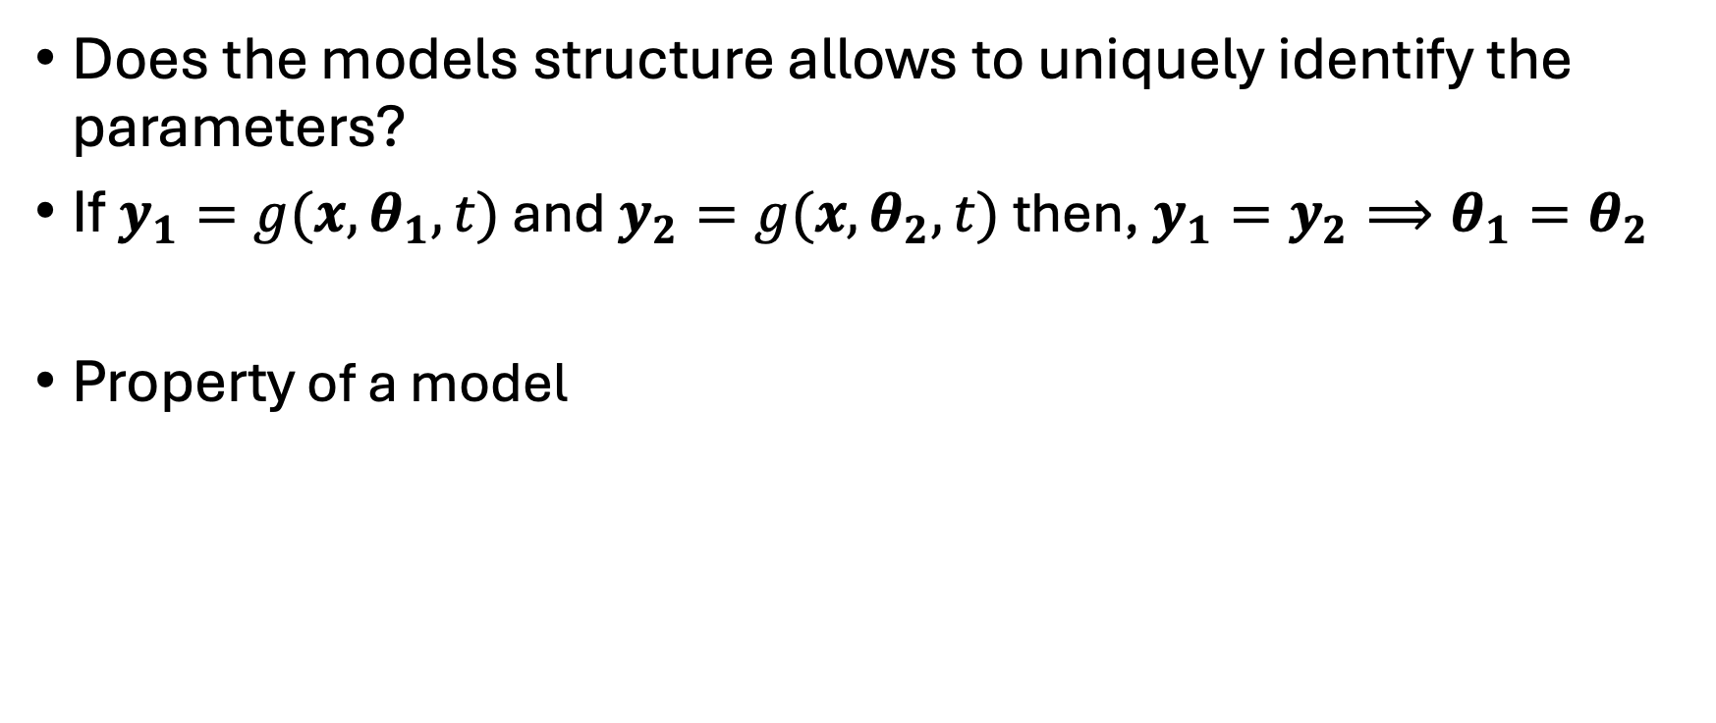
Identifiability
Does the models structure allows to uniquely identify the parameters?
If $y_{1}=g(x,θ_{1},t)$ and $y_{2}=g(x,θ_{2},t)$ then, $y_{1}=y_{2}⟹θ_{1}=θ_{2}$
Property of a model

Slide 4
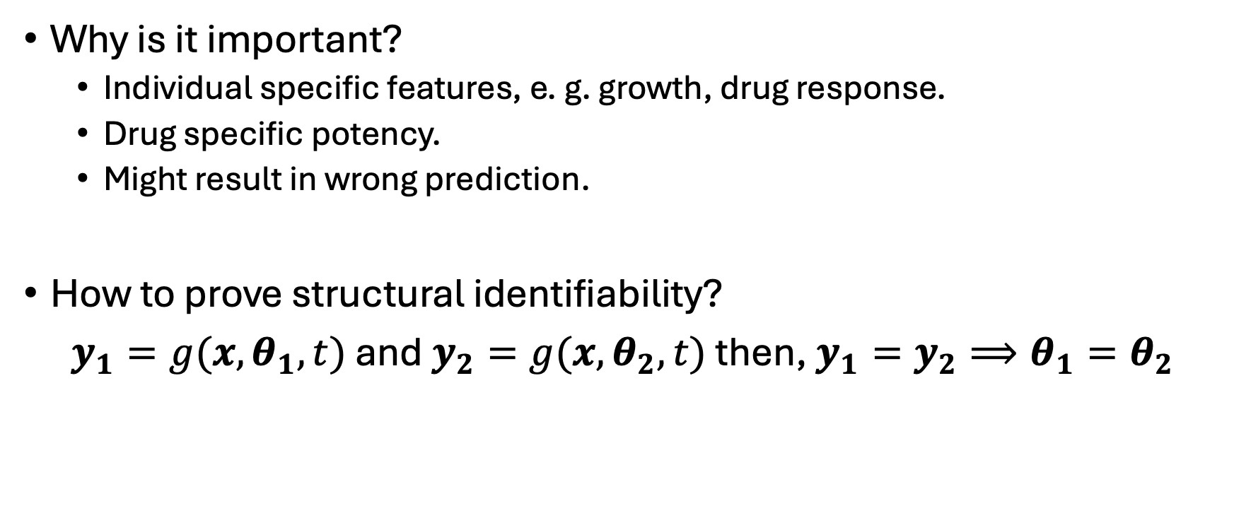
Identifiability
Why is it important?
Individual specific features, e. g. growth, drug response.
Drug specific potency.
Might result in wrong prediction.
How to prove structural identifiability?
$y_{1}=g(x,θ_{1},t)$ and $y_{2}=g(x,θ_{2},t)$ then, $y_{1}=y_{2}⟹θ_{1}=θ_{2}$

Slide 5
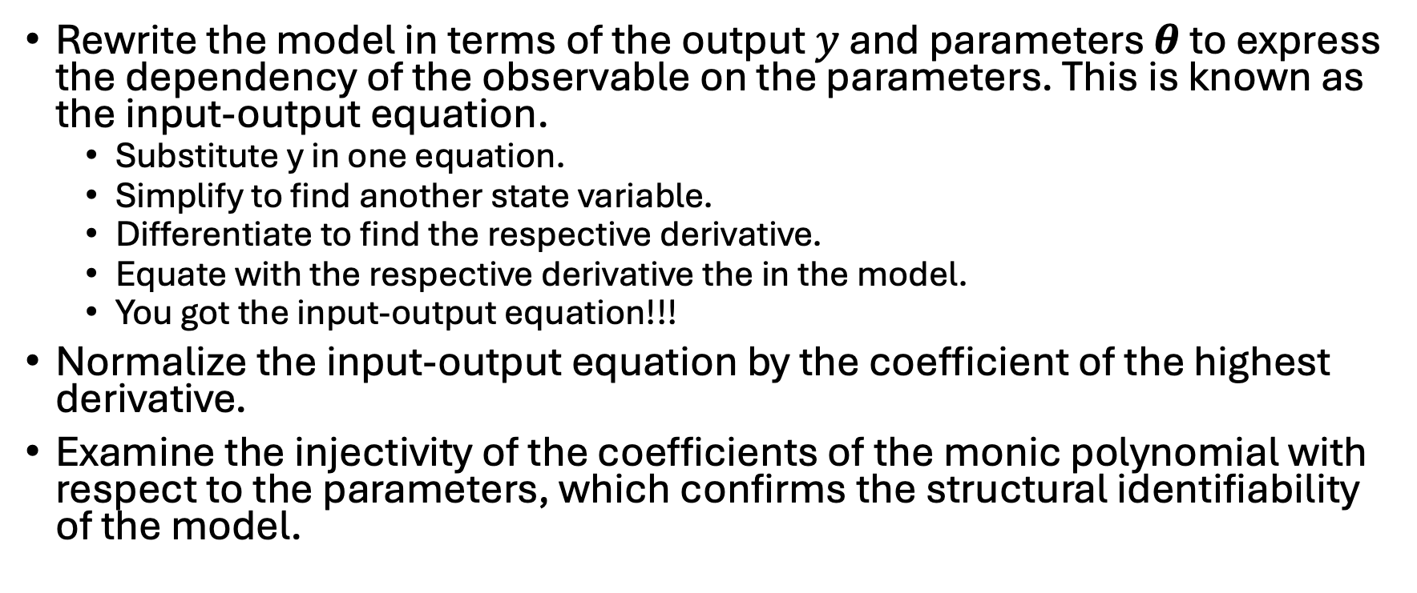
Differential algebra-based approach
Rewrite the model in terms of the output $y$ and parameters $θ$ to express the dependency of the observable on the parameters. This is known as the input-output equation.
Substitute y in one equation.
Simplify to find another state variable.
Differentiate to find the respective derivative.
Equate with the respective derivative the in the model.
You got the input-output equation!!!
Normalize the input-output equation by the coefficient of the highest derivative.
Examine the injectivity of the coefficients of the monic polynomial with respect to the parameters, which confirms the structural identifiability of the model.

Slide 6
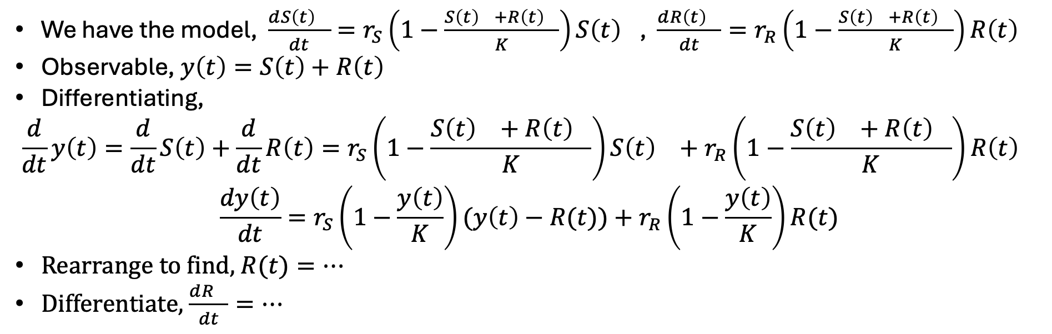
Differential algebra-based approach
We have the model, $\frac{d{S\left(t\right)}_{}}{dt}=r_{S}\left(1−\frac{{S\left(t\right)}_{}+{R\left(t\right)}_{}}{K}\right){S\left(t\right)}_{}$, $\frac{d{R\left(t\right)}_{}}{dt}=r_{R}\left(1−\frac{{S\left(t\right)}_{}+{R\left(t\right)}_{}}{K}\right){R\left(t\right)}_{}$
Observable, $y\left(t\right)=S\left(t\right)+R\left(t\right)$
Differentiating,
$$\frac{d}{dt}y\left(t\right)=\frac{d}{dt}S\left(t\right)+\frac{d}{dt}R\left(t\right)=r_{S}\left(1−\frac{{S\left(t\right)}_{}+{R\left(t\right)}_{}}{K}\right){S\left(t\right)}_{}+r_{R}\left(1−\frac{{S\left(t\right)}_{}+{R\left(t\right)}_{}}{K}\right){R\left(t\right)}_{}$$
$$\frac{dy\left(t\right)}{dt}=r_{S}\left(1−\frac{y\left(t\right)}{K}\right)(y\left(t\right)−R(t))+r_{R}\left(1−\frac{y\left(t\right)}{K}\right)R(t)$$
Rearrange to find, $R(t)=…$
Differentiate, $\frac{dR_{}}{dt}=…$

Slide 7
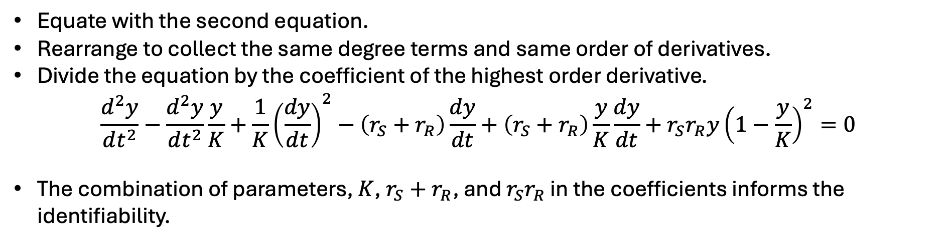
Differential algebra-based approach
Equate with the second equation.
Rearrange to collect the same degree terms and same order of derivatives.
Divide the equation by the coefficient of the highest order derivative.
$$\frac{d^{2}y}{dt^{2}}−\frac{d^{2}y}{dt^{2}}\frac{y}{K}+\frac{1}{K}{\left(\frac{dy}{dt}\right)}^{2}−\left(r_{S}+r_{R}\right)\frac{dy}{dt}+\left(r_{S}+r_{R}\right)\frac{y}{K}\frac{dy}{dt}+{r_{S}r_{R}y\left(1−\frac{y}{K}\right)}^{2}=0$$
The combination of parameters, $K$, $r_{S}+r_{R}$, and $r_{S}r_{R}$ in the coefficients informs the identifiability.

Slide 8
COMBOS: Web App for Finding Identifiable Parameter Combinations in...
dx1/dt = rS*(1+(x1+x2)/K)*x1;
dx2/dt = rR*(1+(x1+x2)/K)*x2;
y1 = x1+x2;
dx1/dt = rS*(1+(x1+x2)/K)*x1; dx2/dt = rR*(1+(x1+x2)/K)*x2; y1 = x1+x2; x1(0) = 1000;x2(0) = 10;

Slide 9
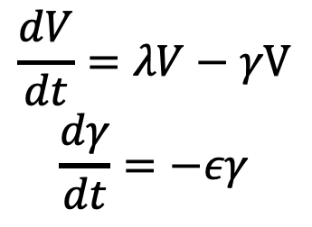
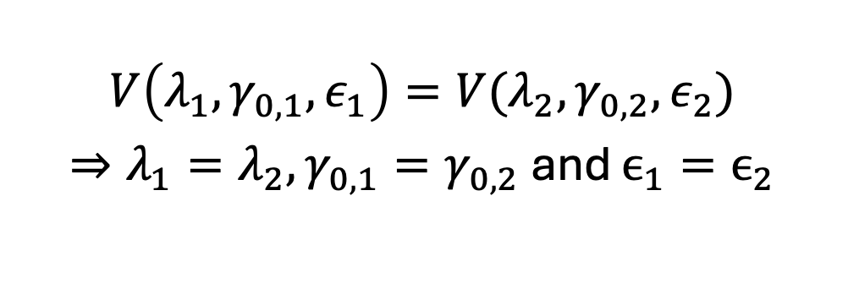
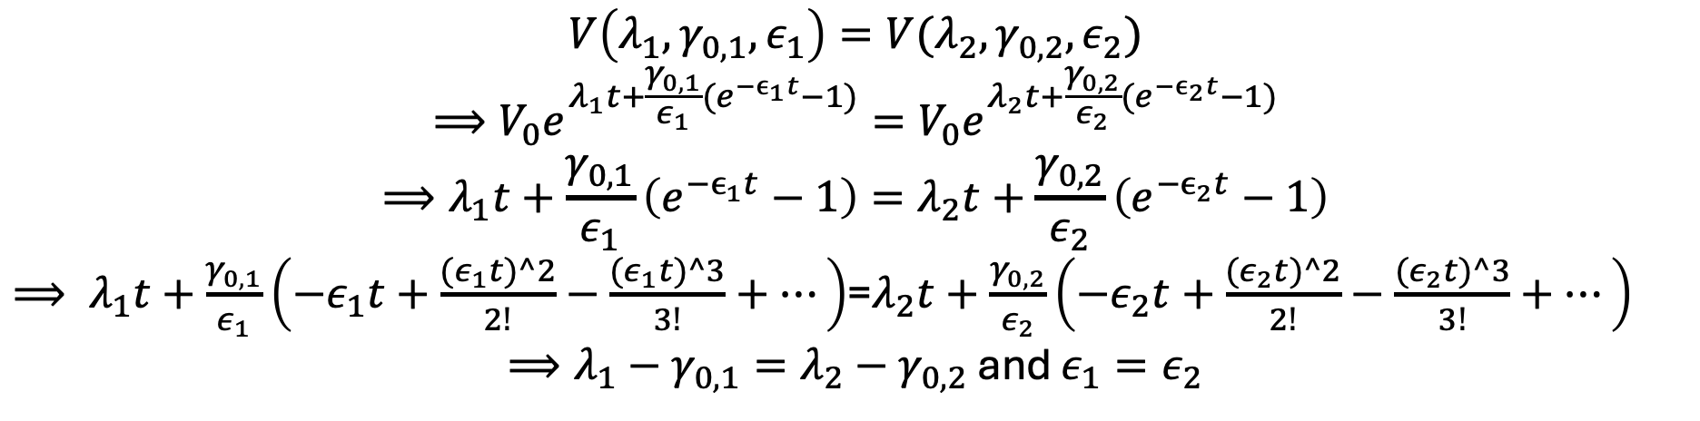
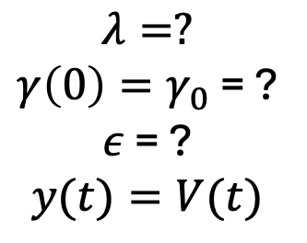
An analytical proof
This is what we need to prove
$$V\left(λ_{1},γ_{0,1},ε_{1}\right)=V(λ_{2},γ_{0,2},ε_{2})$$
$⇒λ_{1}=λ_{2},γ_{0,1}=γ_{0,2}$ and $ϵ_{1}=ϵ_{2}$
$$\frac{dV}{dt}=λV−γV$$
$$\frac{dγ}{dt}=−εγ$$
$$λ=?$$
$γ\left(0\right)=γ_{0}$ = ?
$ε$ = ?
$$y(t)=V(t)$$
Let’s try …
$$V\left(λ_{1},γ_{0,1},ε_{1}\right)=V(λ_{2},γ_{0,2},ε_{2})$$
$$⟹V_{0}e^{λ_{1}t+\frac{γ_{0,1}}{ε_{1}}(e^{−ϵ_{1}t}−1)}=V_{0}e^{λ_{2}t+\frac{γ_{0,2}}{ε_{2}}(e^{−ϵ_{2}t}−1)}$$
$$⟹λ_{1}t+\frac{γ_{0,1}}{ε_{1}}\left(e^{−ϵ_{1}t}−1\right)=λ_{2}t+\frac{γ_{0,2}}{ε_{2}}\left(e^{−ϵ_{2}t}−1\right)$$
$⟹ λ_{1}t+\frac{γ_{0,1}}{ε_{1}}\left(−ε_{1}t+\frac{{(ε}_{1}t)^2}{2!}−\frac{{(ε}_{1}t)^3}{3!}+…\right)$=$λ_{2}t+\frac{γ_{0,2}}{ε_{2}}\left(−ε_{2}t+\frac{{(ε}_{2}t)^2}{2!}−\frac{{(ε}_{2}t)^3}{3!}+…\right)$
$⟹λ_{1}−γ_{0,1}=λ_{2}−γ_{0,2}$ and $ε_{1}=ε_{2}$

Slide 10
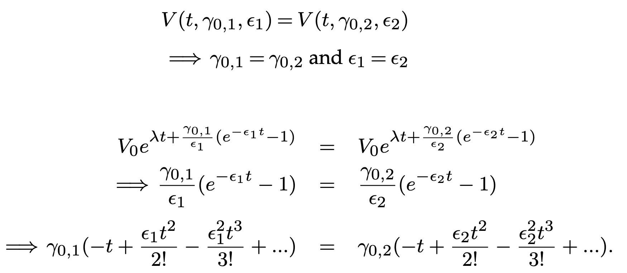
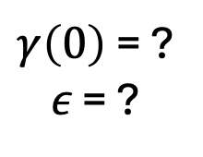
An analytical proof
Structural
Identifiability
$$\frac{dV}{dt}=λV−γV$$
$$\frac{dγ}{dt}=−εγ$$
$γ\left(0\right)$ = ?
$ε$ = ?
Taylor’s
expansion

Slide 11
To-dos to ease identifiability
Come up with a possibly simpler model.
Leave least number of parameters to estimate
Adopt reasonable parameter values from the literature.
Fix least sensitive parameters and estimate the rest.
Maximize the observables.

Slide 12
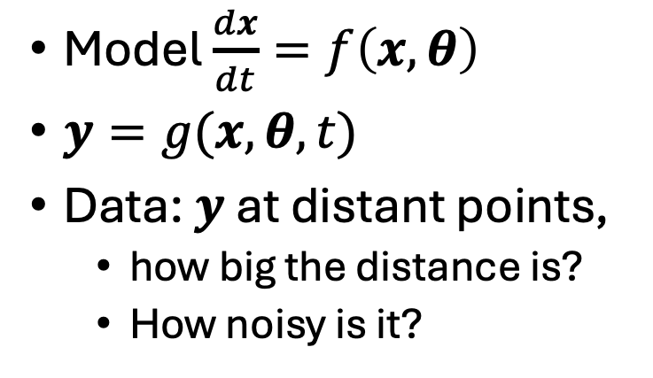
Practical identifiability
Model $\frac{dx}{dt}=f\left(x,θ\right)$
$y=g(x,θ,t)$
Data: $y$ at distant points,
how big the distance is?
How noisy is it?

Slide 13
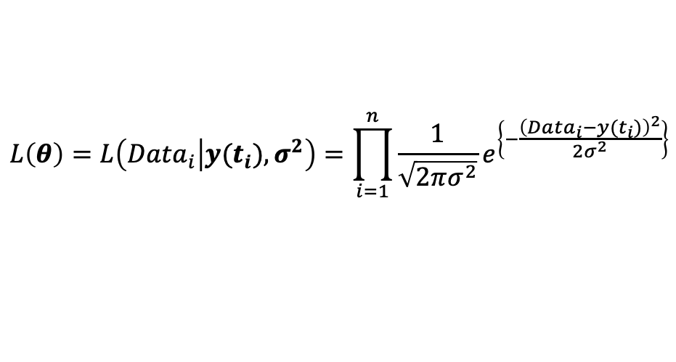

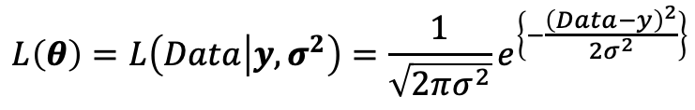




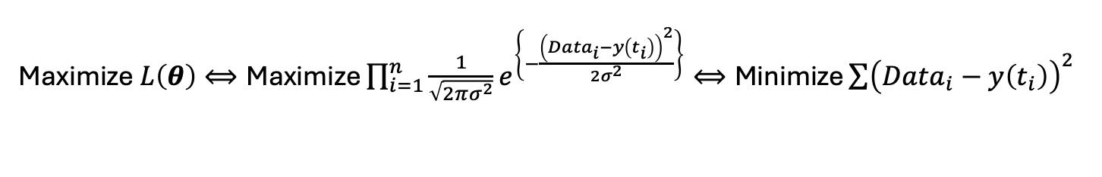
Parameter estimation
Random Variable$\sim N(y,σ^{2})$
$$θ$$
$$f\left(x,θ\right)$$
$$x$$
$$y≈Data$$
?
Error
Realization/Sample
$$L\left(θ\right)=L\left(Data | y,σ^{2}\right)=\frac{1}{\sqrt{2πσ^{2}}}e^{\left\{−\frac{{\left(Data−y\right)}^{2}}{2σ^{2}}\right\}}$$
$$L\left(θ\right)=L\left(Data_{i} | y(t_{i}),σ^{2}\right)=\prod_{i=1}^{n}{\frac{1}{\sqrt{2πσ^{2}}}e^{\left\{−\frac{{\left(Data_{i}−y(t_{i})\right)}^{2}}{2σ^{2}}\right\}}}$$
Maximize $L\left(θ\right)⟺\text{Maximize}\prod_{i=1}^{n}{\frac{1}{\sqrt{2πσ^{2}}}e^{\left\{−\frac{{\left(Data_{i}−y\left(t_{i}\right)\right)}^{2}}{2σ^{2}}\right\}}⟺\text{M}\text{in}\text{imize}}\sum{{\left(Data_{i}−y\left(t_{i}\right)\right)}^{2}}$

Slide 14
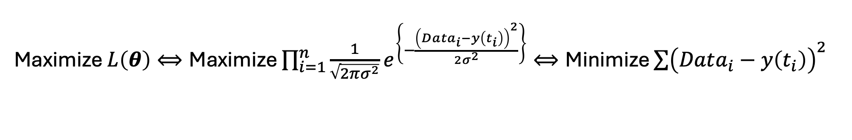
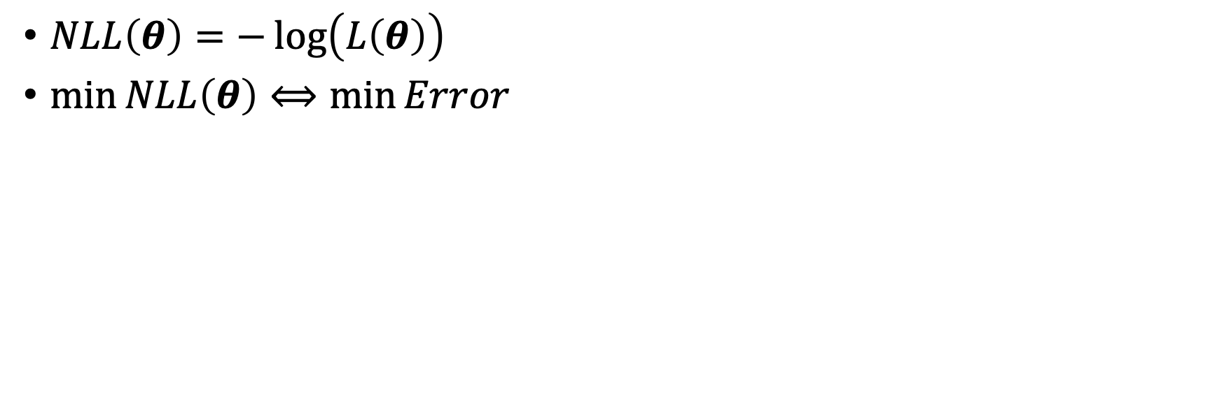
Parameter estimation
Maximize $L\left(θ\right)⟺\text{Maximize}\prod_{i=1}^{n}{\frac{1}{\sqrt{2πσ^{2}}}e^{\left\{−\frac{{\left(Data_{i}−y\left(t_{i}\right)\right)}^{2}}{2σ^{2}}\right\}}⟺\text{M}\text{in}\text{imize}}\sum{{\left(Data_{i}−y\left(t_{i}\right)\right)}^{2}}$
$NLL\left(θ\right)=−\log\left(L\left(θ\right)\right)$
$\min{NLL\left(θ\right)}⟺\min{Error}$

Slide 15



Profile likelihood
$θ=\left[θ_{1},θ_{2},θ_{3}\right]$
Estimated parameter $\hat{θ}=\left[{\hat{θ}}_{1},{\hat{θ}}_{2},{\hat{θ}}_{3}\right]$
$PL\left(θ_{1}\right)=\min_{θ_{2},θ_{3}}{NLL\left({\hat{θ}}_{2},{\hat{θ}}_{3}\right)}$ for$θ_{1}∈[{\hat{θ}}_{1}−δ,{\hat{θ}}_{1}+δ]$
$$Least Error$$
$${{\hat{θ}}_{1}−δ \hat{θ}}_{1} {\hat{θ}}_{1}+δ$$

Slide 16
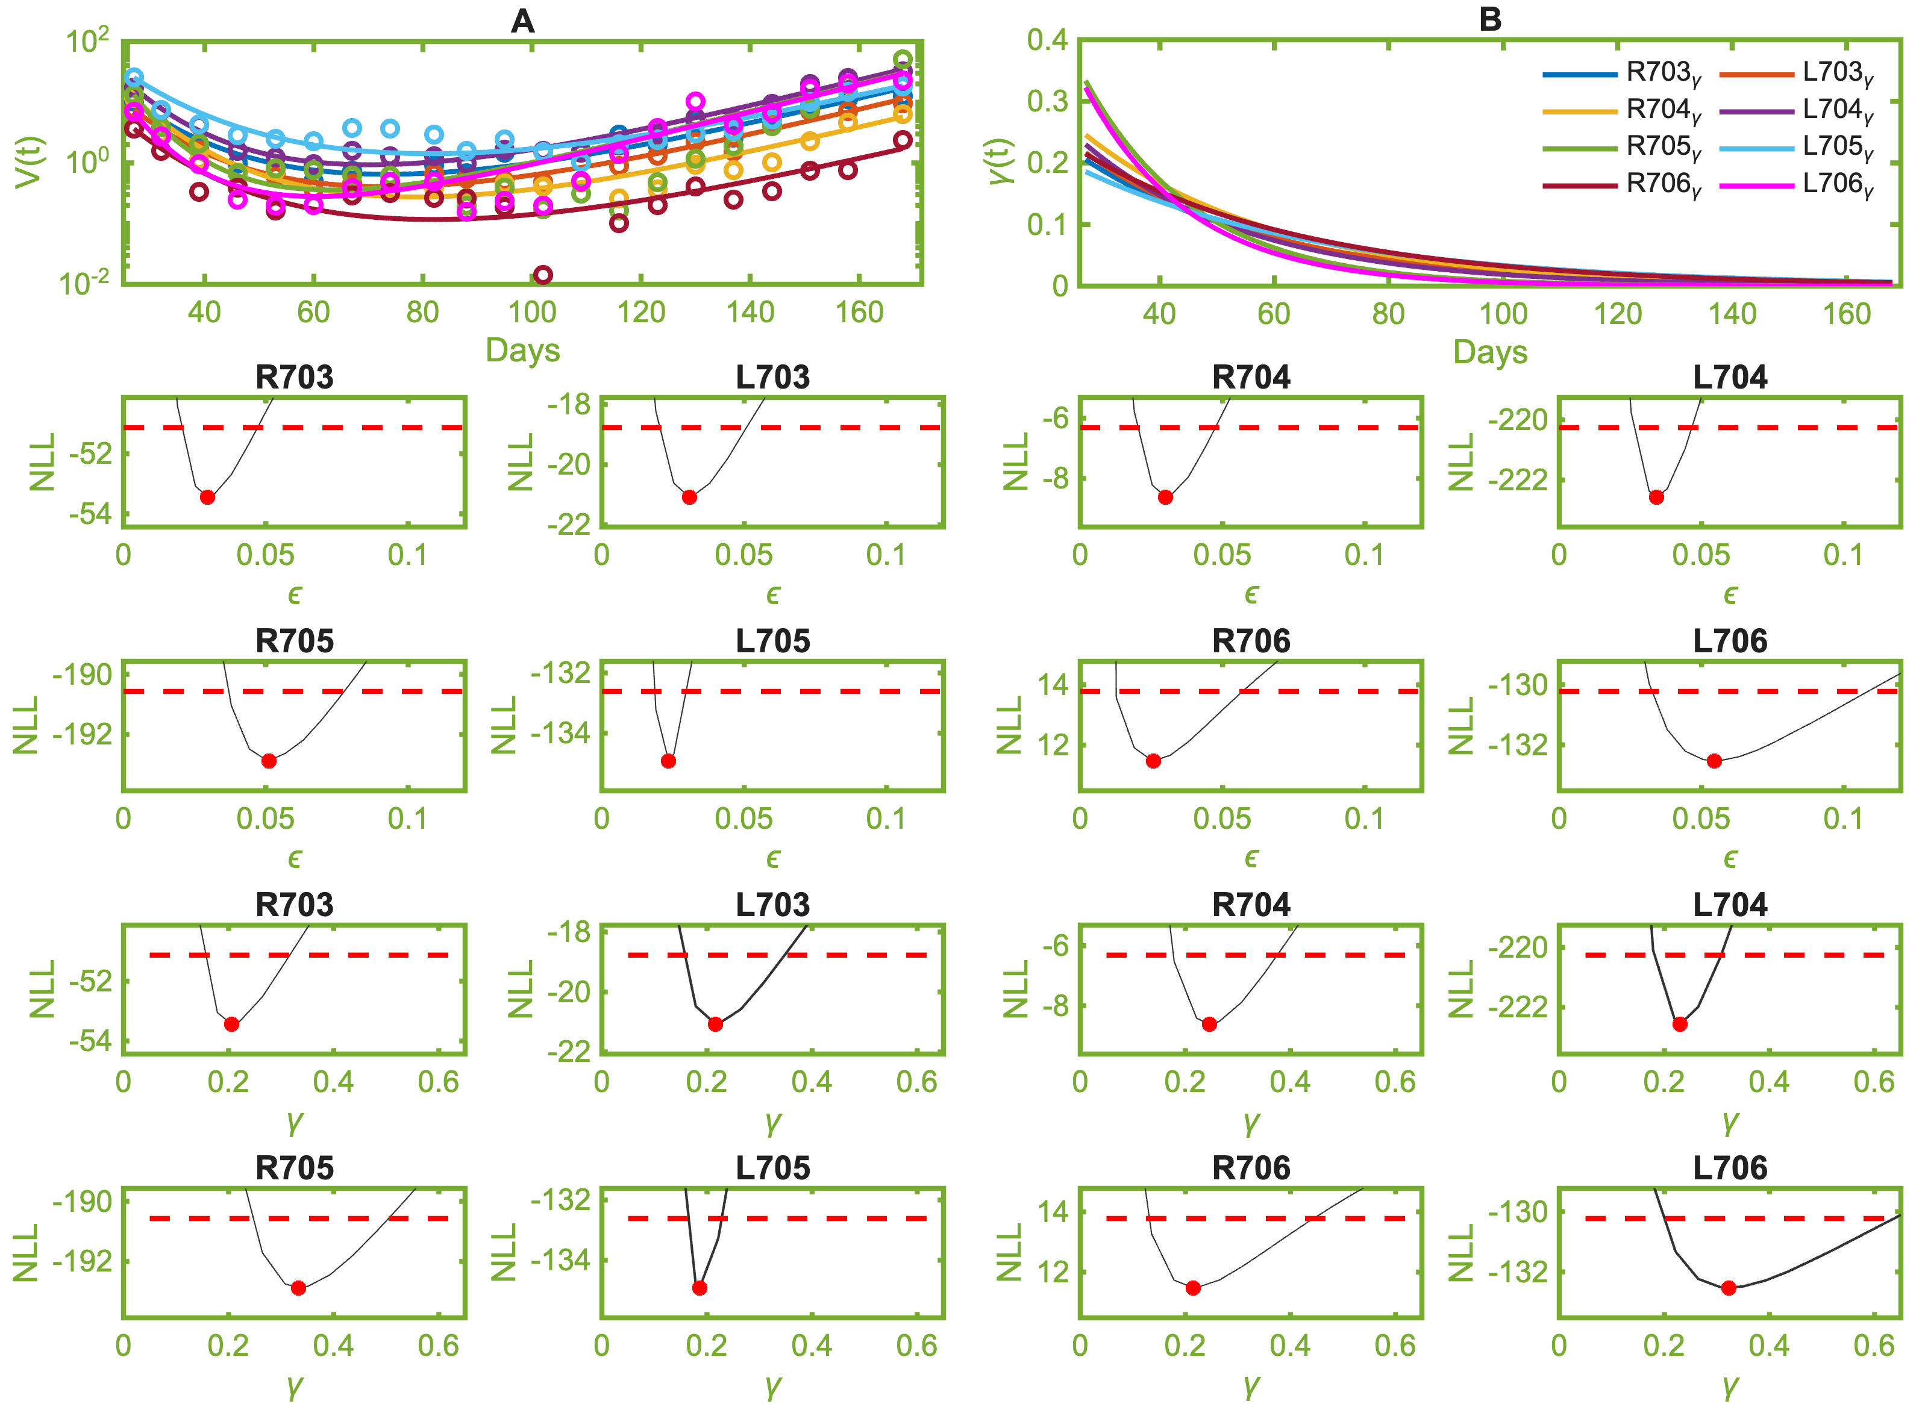

Practical identifiability
$$Least Error + Invχ^{2}(0.9,2)$$

Slide 17
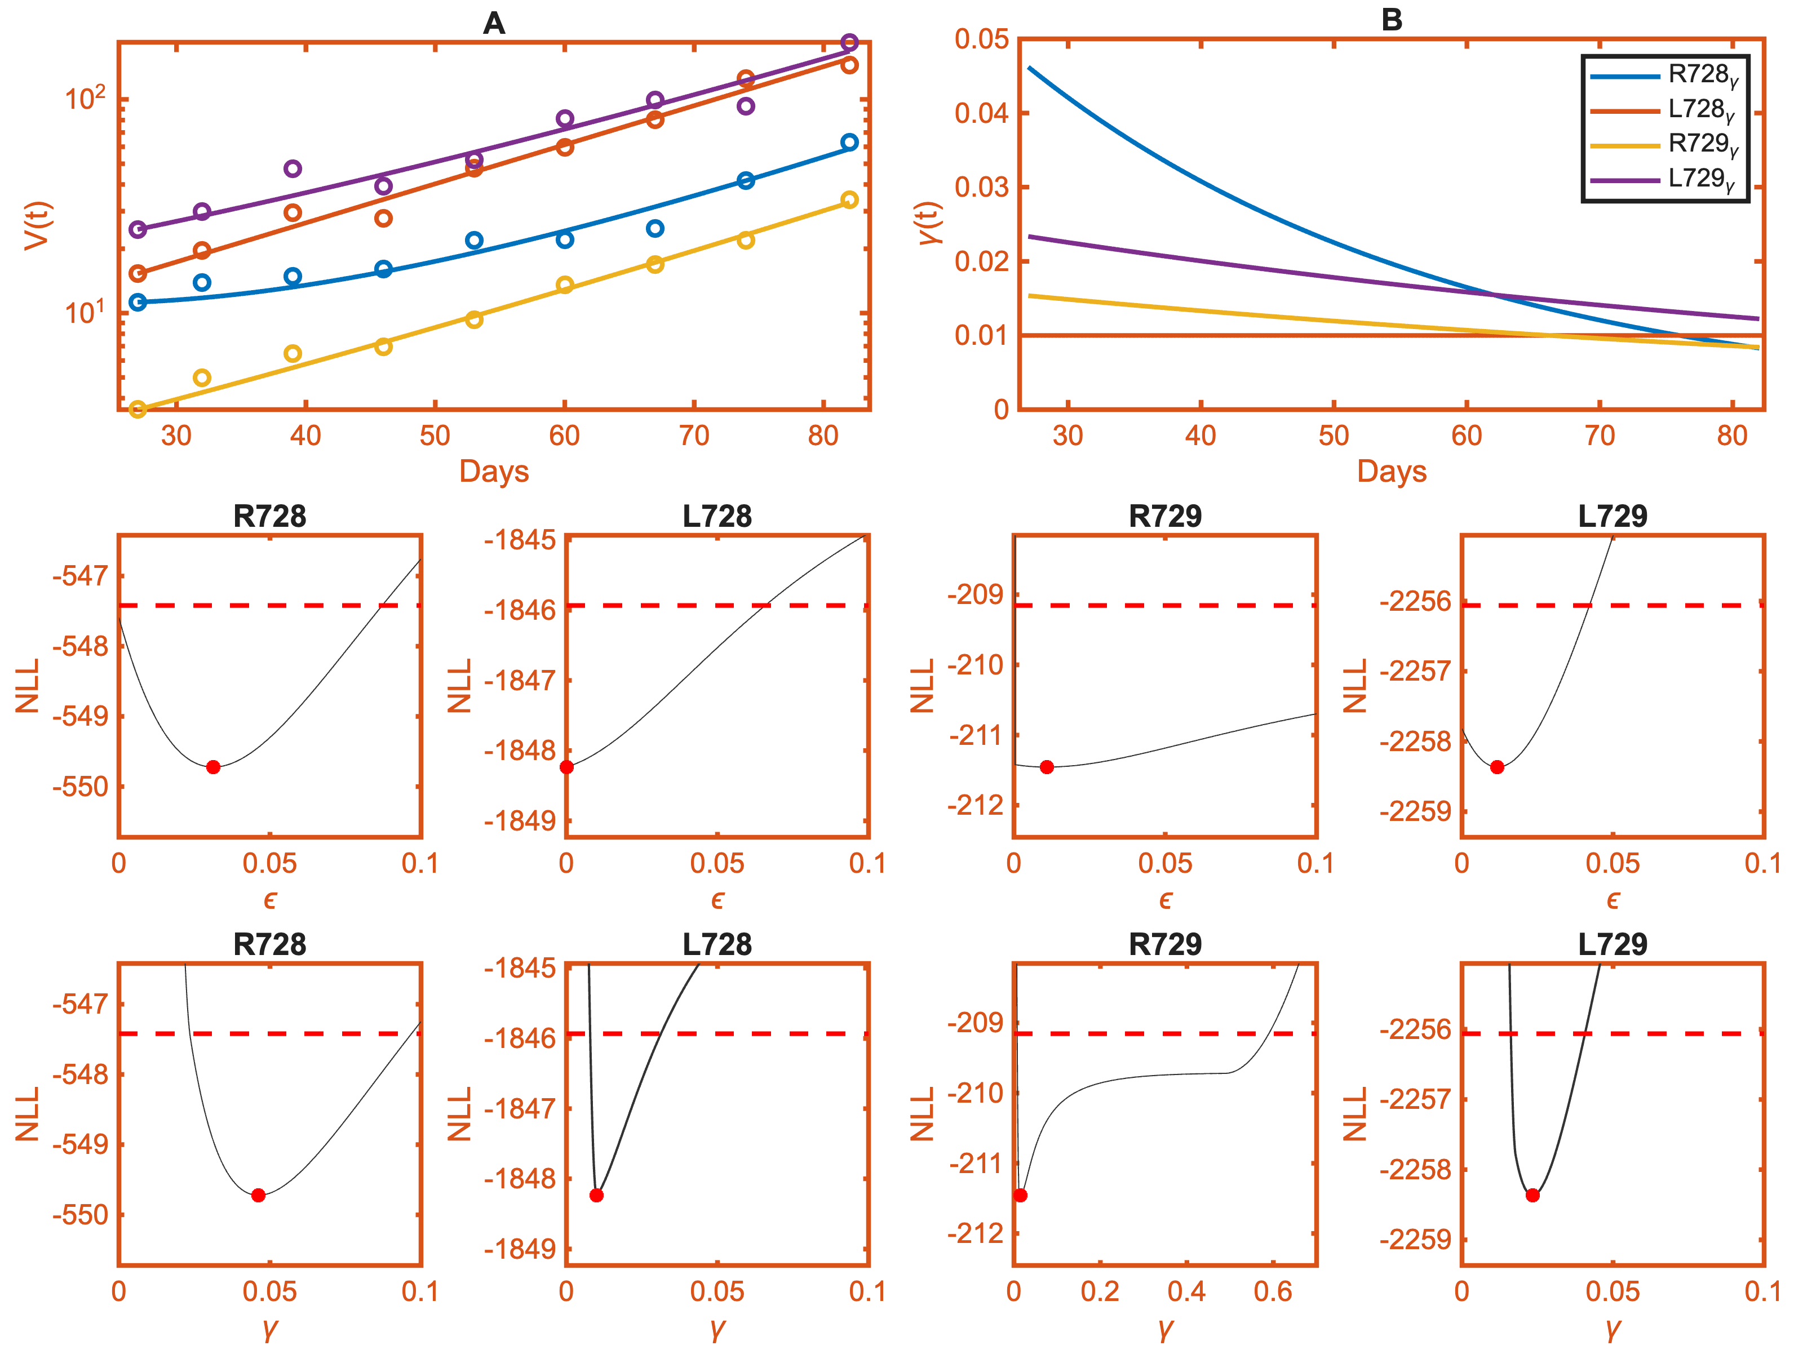
Practical identifiability fails

Slide 18



Resources
https://epimath.org/
Video lectures
https://www.imsi.institute/videos/identifiability-and-infectious-disease-models-exploring-the-structure-of-uncertainty/
https://www.youtube.com/watch?v=_5is1F9tKTk

